Slide 1
Theory of Automata
Lecture #20-21

Slide 2
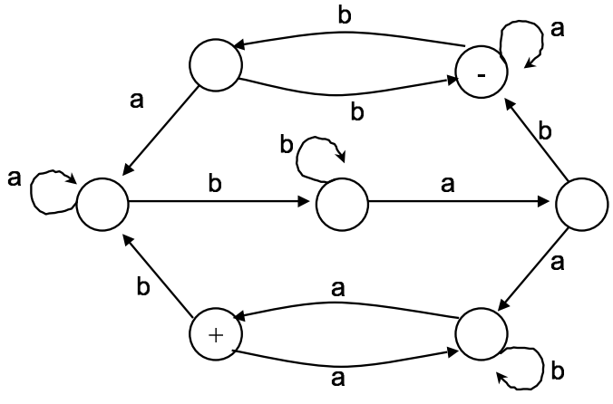
Circuits
A Circuit is a path which starts and ends at the same state

Slide 3
Circuits
…abbab…

Slide 4
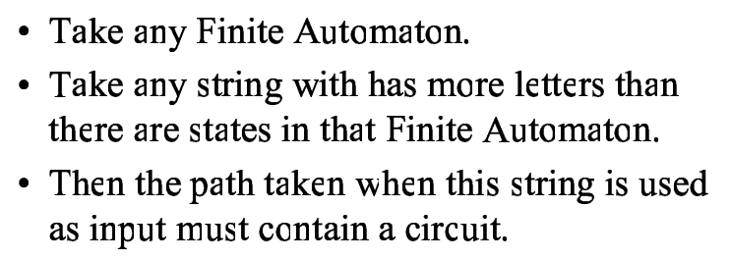
Observation

Slide 5


Circuits
Given String is:

Slide 6
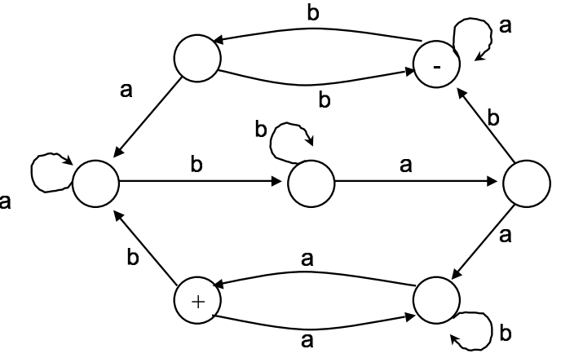

Circuits

Slide 7
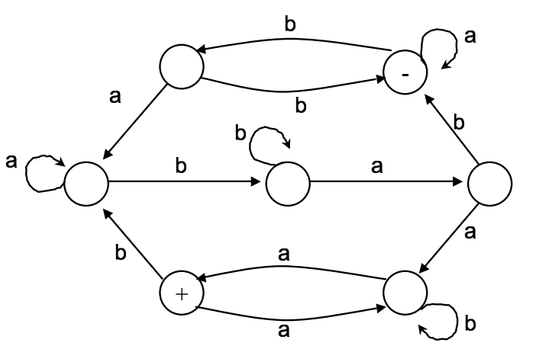

Circuits
Notes:
Repeating to make a string of the form xy^{n}z where y is non-zero

Slide 8
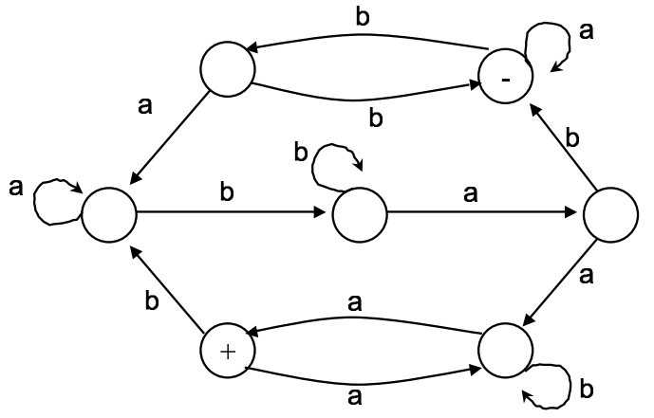

Circuits-Another String
Input String:

Slide 9
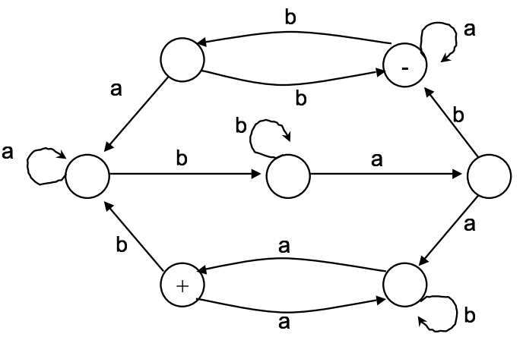

Circuits-Another String

Slide 10
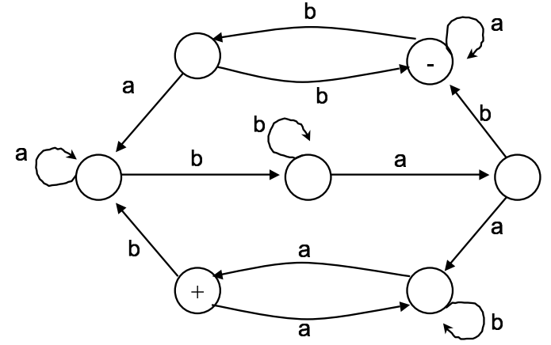

Circuits-Another String

Slide 11
Context Free Grammar
A context-free grammar (CFG) is a set of recursive rewriting rules (or productions) used to generate patterns of strings.
A context-free grammar (CFG) is a formal grammar in which every production rule is of the form
V → w

Slide 12
CFG Components
A CFG consists of the following components:
a set of terminal symbols, which are the characters of the alphabet that appear in the strings generated by the grammar.
a set of non-terminal symbols, which are placeholders for patterns of terminal symbols that can be generated by the non-terminal symbols.

Slide 13
CFG Components…
A CFG consists of the following components:
a set of productions, which are rules for replacing (or rewriting) non-terminal symbols (on the left side of the production) in a string with other non-terminal or terminal symbols (on the right side of the production).
a start symbol, which is a special non-terminal symbol that appears in the initial string generated by the grammar.

Slide 14
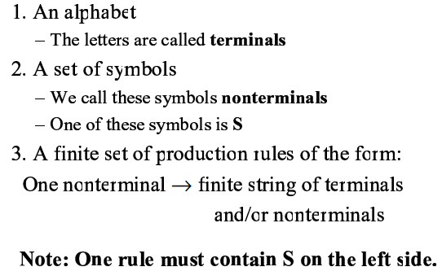
CFG Components

Slide 15
String Generation from CFG
To generate a string of terminal symbols from a CFG, we
Begin with a string consisting of the start symbol
Apply one of the productions with the start symbol on the left hand size, replacing the start symbol with the right hand side of the production

Slide 16
String Generation from CFG…
Repeat the process of selecting non-terminal symbols in the string, and replacing them with the right hand side of some corresponding production, until all non-terminals have been replaced by terminal symbols.

Slide 17
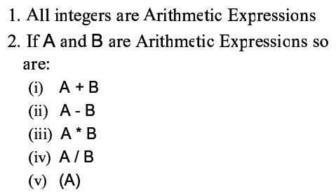
Arithmetic Expression

Slide 18
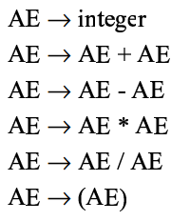
Production Rules

Slide 19
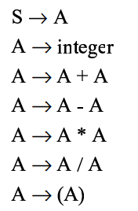
Production Rules

Slide 20

Backus Normal Form

Slide 21
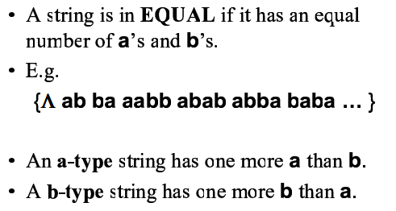
Definitions

Slide 22
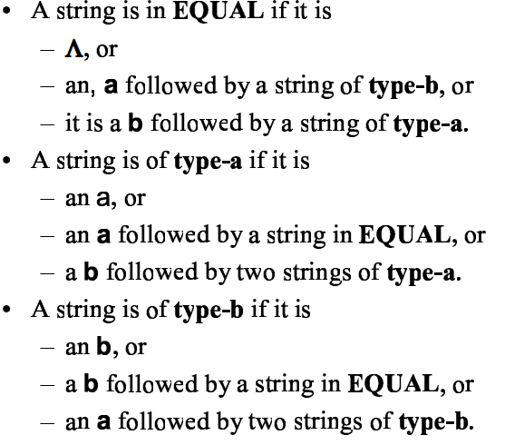
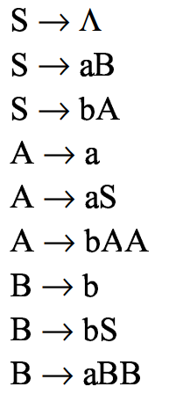
Definition of Equal

Slide 23
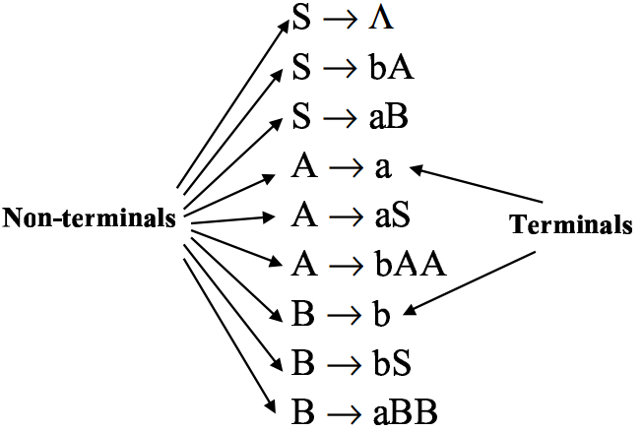
Production Rules

Slide 24

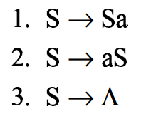
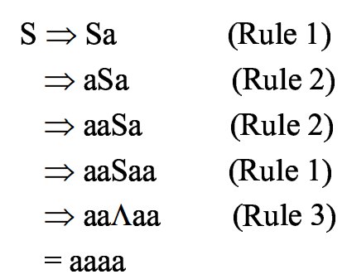
Simple String Generation
Production Rules
Generate aaaa String from given CFG

Slide 25
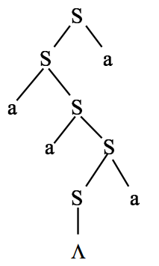
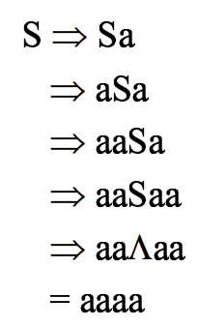
Parse Tree

Slide 26
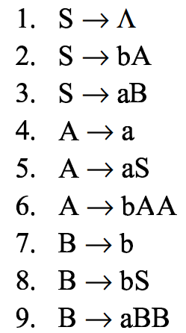
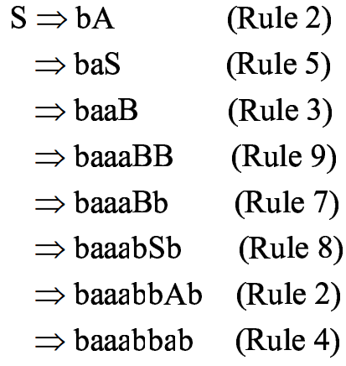
EQUAL
Generate baaabbab from language of equal

Slide 27
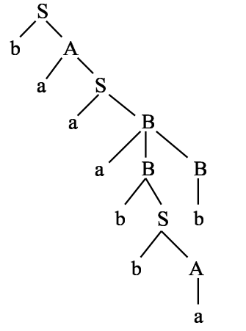
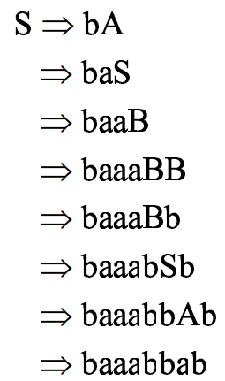
Parse Tree of EQUAL

